Slide 1
Non-Parametric Statistics
MSDS 660

Slide 2
What is Parametric?
Parametric
Non-parametric
Assumes data comes from a distribution
Gaussian, t-distribution, F-distribution
Large sample size
No assumptions about the distribution of data
Typically tests central tendency of two populations
Mean or median
Small sample size
> 30 ish

Slide 3
Review: Parametric
Types of distributions
Types of tests
Gaussian
t-distribution
F-distribution
Binomial
Chi-squared
Gamma
Poisson
Beta
t-test: t.test()
z-test: z.test()
ANOVA (F-test): aov()
Pearson’s correlation: cor(method = ‘pearson’)
Most of the post-hoc tests

Slide 4
Non-Parametric Testing
When to use
If the underlying distribution is unknown
If data is ordinal or ranked
Data contains a lot of outliers or is very skewed
Small sample sizes
Types of non-parametric testing
Sign test
Wilcoxen signed-rank test
Mann-Whitney U-test
Kruskal-Wallis test
Kolmogorov-Smirnov test
Anderson-Darling Test
Spearman’s Rank Correlation Coefficient
Difference in medians
Distribution

Slide 5
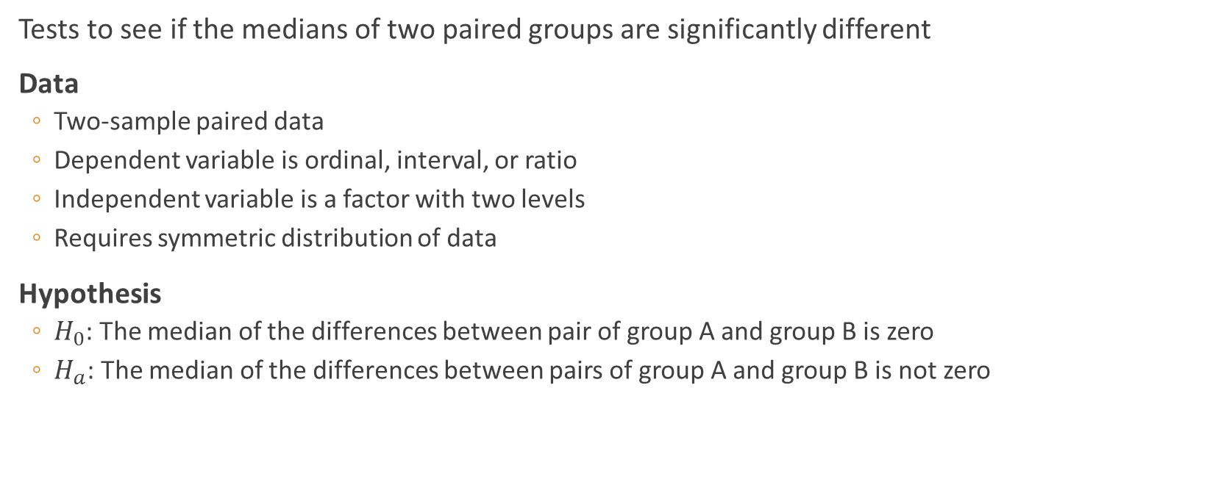
Sign Test
Tests to see if the medians of two paired groups are significantly different
Data
Two-sample paired data
Dependent variable is ordinal, interval, or ratio
Independent variable is a factor with two levels
Requires symmetric distribution of data
Hypothesis
$H_{0}$: The median of the differences between pair of group A and group B is zero
$H_{a}$: The median of the differences between pairs of group A and group B is not zero

Slide 6
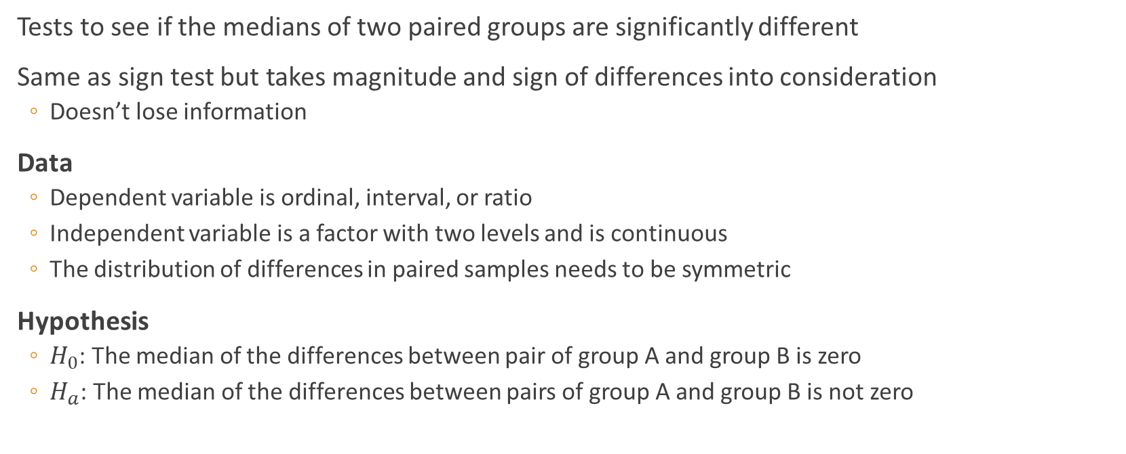
Wilcoxen signed-rank test
Tests to see if the medians of two paired groups are significantly different
Same as sign test but takes magnitude and sign of differences into consideration
Doesn’t lose information
Data
Dependent variable is ordinal, interval, or ratio
Independent variable is a factor with two levels and is continuous
The distribution of differences in paired samples needs to be symmetric
Hypothesis
$H_{0}$: The median of the differences between pair of group A and group B is zero
$H_{a}$: The median of the differences between pairs of group A and group B is not zero

Slide 7
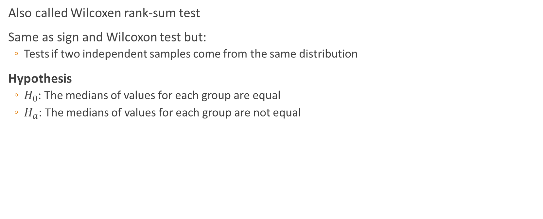
Mann-Whitney U-test
Also called Wilcoxen rank-sum test
Same as sign and Wilcoxon test but:
Tests if two independent samples come from the same distribution
Hypothesis
$H_{0}$: The medians of values for each group are equal
$H_{a}$: The medians of values for each group are not equal

Slide 8

Kruskal-Wallis
The non-parametric equivalent of one-way ANOVA
Still testing if the medians are the same…
Hypothesis
$H_{0}$: All group medians are the same
$H_{a}$: Group medians not all equal

Slide 9

Komogorov-Smirnov
Tests if the distribution between samples are significantly different
Hypothesis
$H_{0}$: Distribution between samples are from the same distribution
$H_{a}$: Distribution between samples are not from the same distribution

Slide 10

Anderson-Darling
Tests if data comes from a Gaussian distribution
Must have over 7 points
Hypothesis
$H_{0}$: Data comes from normal distribution
$H_{a}$: Data does not come from the normal distribution

Slide 11
In-Class Assignment
Use the datasets on worldclass:
new_flu_shot.csv
mpg.tsv
vocab.csv
Decide which parametric or non-parametric test to use for each case, and explain why. You can also use more than 1 test on a dataset, if there is more than one test that would work for it.
Post your results and analysis to the discussion forum.

Slide 12
Homework
Use the pacebo_new_drug.xlsx complete and analyze the data using non-parametric tests

